Slide 1
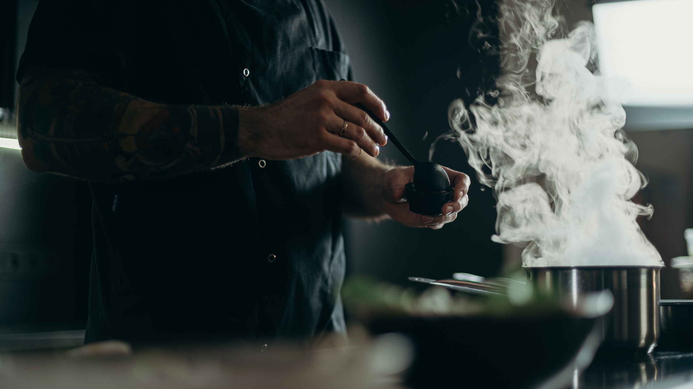
140°F
where green energy delivers hot meals

Slide 2
Part 1:
Idea, Impact, & Objectives
Table of Contents
Part 2:
Key industry drivers, competitors, & Innovation
Part 3:
Implementation plan for the first year
Part 4:
Financial projections for the first two years

Slide 3

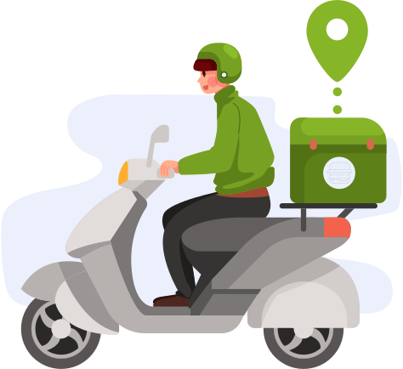
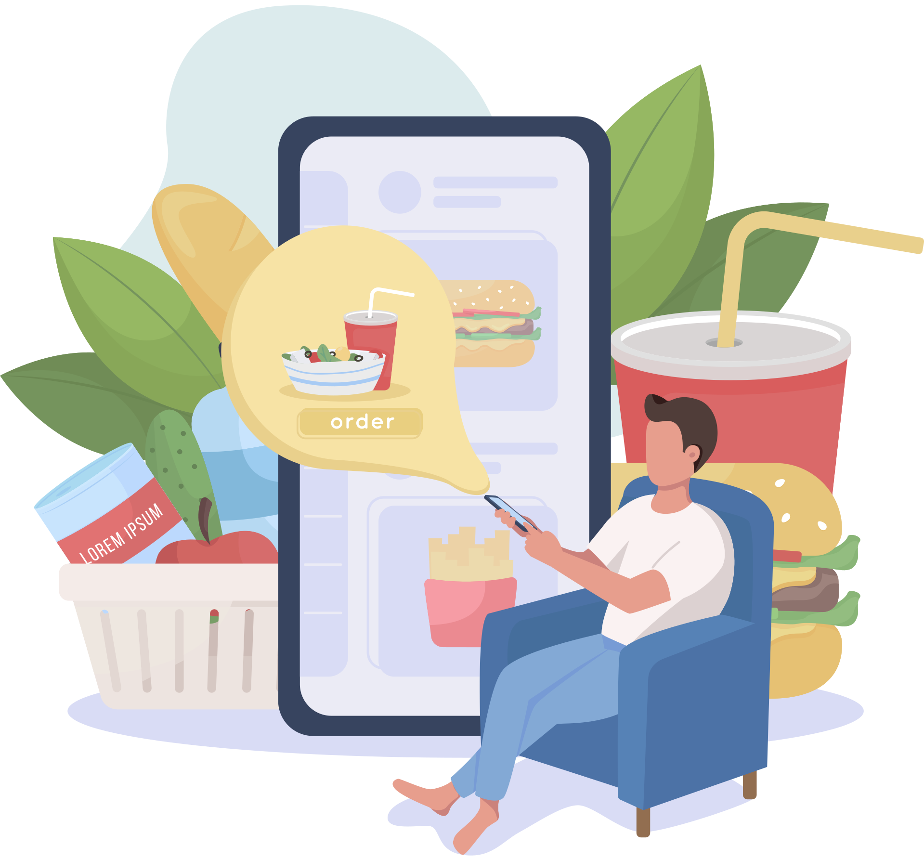

How about someone delivers hot, fresh, and lip smacking meal at your doorstep?
Yes, this can happen! It hurts when we crave our favorite meal but then receive it all cold and soggy. Just a small change in a delivery box can help people enjoy their meals at home itself. All that we can do, use green energy i.e. designing a delivery box with a solar hybrid system. Solar energy can provide enough electricity to heat food items present in the 3/4th section of the box to a particular temperature (1/4th section for cold items) and hence we can fulfill our purpose of delivering hot and fresh food.
Food Delivery vs Dining
In Covid-19 lockdowns where we saw restaurants shutting down for dining, food deliveries got a great shoot! Today, just a few taps on our device and we get our order of 'bahar ka khana'. But some people still don't consider food delivery worth substituting dining and are obsessed with those dining vibes. So to avoid unnecessary gatherings at dining, we all should promote food delivery and try to find solutions to its barriers. Therefore considering all the aspects, we take a step towards building a better working world!
Objectives:
In this ongoing pandemic, we believe in promoting food delivery so that people can enjoy hot and fresh meals at home/personal space itself.
Since India is endowed with vast solar energy potential, we take this initiative to use green energy most efficiently.
Delivery boxes catch attention of many eyes, so we plan to make the best use of all the faces of the box. Such as using one side for installing a solar panel and then the rest for advertising!

Slide 4
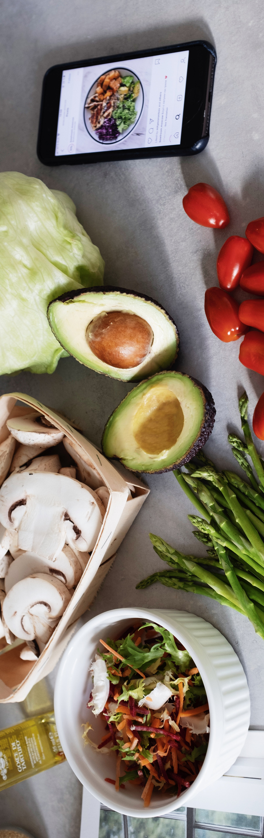
TODAY WHERE EVERYONE IS BUSY RUNNING FOOD DELIVERY SERVICES,
WE ALSO JOIN HANDS BUT WITH A SMALL INNOVATION I.E. MODIFYING A
DELIVERY BOX USING GREEN ENERGY. WITH THIS, WE PLAN TO
OVERCOME SOME CHALLENGES FACED AND HENCE SERVE THE CURRENT
DEMAND OF FOOD DELIVERY.
KEY INDUSTRY DRIVERS
KEY INDUSTRY COMPETITORS
01
01
Multi cuisine, hot, and fresh food in minutes (also with a health & diet section in the menu)
Restaurants with Zomato/Swiggy being their delivery partners
02
02
Prime location - Bengaluru
The location can be customized with an increase in no.of outlets
Pizza delivery services delivering hot and fresh pizza for sure. This reduces our cuisine options.
03
03
Contact-less delivery
Restaurants offering dining as well

Slide 5



1st Quarter:
3rd Quarter:
Every Month
Plan: 45% of the budget on one time expenses and start with a launching scheme!
Risk: The scheme doesn't attract much audience
Solution: Study the audience and hence keep backup launching schemes
Plan: Hire delivery staff on commission basis (but our own delivery boxes).
Risk: Uncertainties in their delivery service
Solution: Backup bikes bought in the first quarter or personal vehicles
Track the operational expenses
Conduct performance surveys
Maintenance check on all appliances, delivery boxes, and infrastructure
Keeping track of latest trends for advertising
First
Year
( Investment of approx. 10 lakhs)
2nd Quarter:
4th Quarter:
Plan: Start with a landing scheme and advertise it as much as possible
Risk: Existing schemes in market gaining more attention
Solution: Since through the launching scheme we aim to receive a data bank, so may go for personal approach
Plan: Introduce a health and diet section in our menu with mentioned statistics
Risk: Food wastage incase we don't get a good response
Solution: Collaborate with an NGO beforehand to give the wasted food
The Delivery Box:
Bikes will be parked in sunlight so that using charged batteries, delivery boxes function efficiently at night
A heating element will be present in the 3/4th section of the box. Solar Energy
Since food should be served at 140 F or above therefore a controllable temperature sensor will be placed outside the box.
Rest 3 visible faces of the box will be used for advertising (or partnerships)
Use QR codes for quick responses ( Linktree link )
Electrical Energy
Heat
Solar panels
Advertising

Slide 6
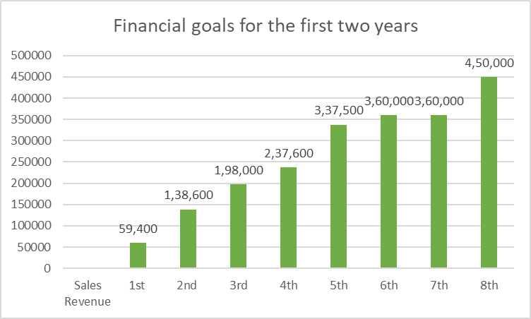
One time/ Fixed Expenses:
Revenue :
Legal formalities, Rent & Security, Salaries, Infrastructure, Electronic devices, Kitchen setup, Restaurant app and website, EMI of bikes, Delivery boxes, Zomato/Swiggy Commission (later partnership)
No. of orders*Average price of an order - Sales Revenue
(According to 2021 statistics, majority of people spent Rs. 200-500/Order.
About 21% of people spent less than 200/Order)
Cumulation of all revenue generating channels of our company - Total Revenue
Channels: 1. Sales 2. Investments (in 6th/7th quarter) 3. Advertising
4. Sponsorships 5. Paid Collaborations
Operational Expenses:
Advertising, Raw materials, Commission based salaries, Fuel, Packaging, Stationary
Source of Operating Profit - Sales and Advertising
Operating Cost breakdown:
Goals:
1st Year: Loss <= 20% 2nd Year: Profit >= 10%
Food cost
Rent and utility cost
Delivery cost
Marketing and Advertising
Marketing and Advertising:
Offline: Flex, Pamphlets, Delivery boxes, Sponsoring events and competitions
Online: Social Media Marketing (Instagram, Facebook, LinkedIn, YouTube), Google Ads, Email Marketing, Premium memberships, Coupons/Vouchers/Promo Codes, Referral Schemes

Slide 7
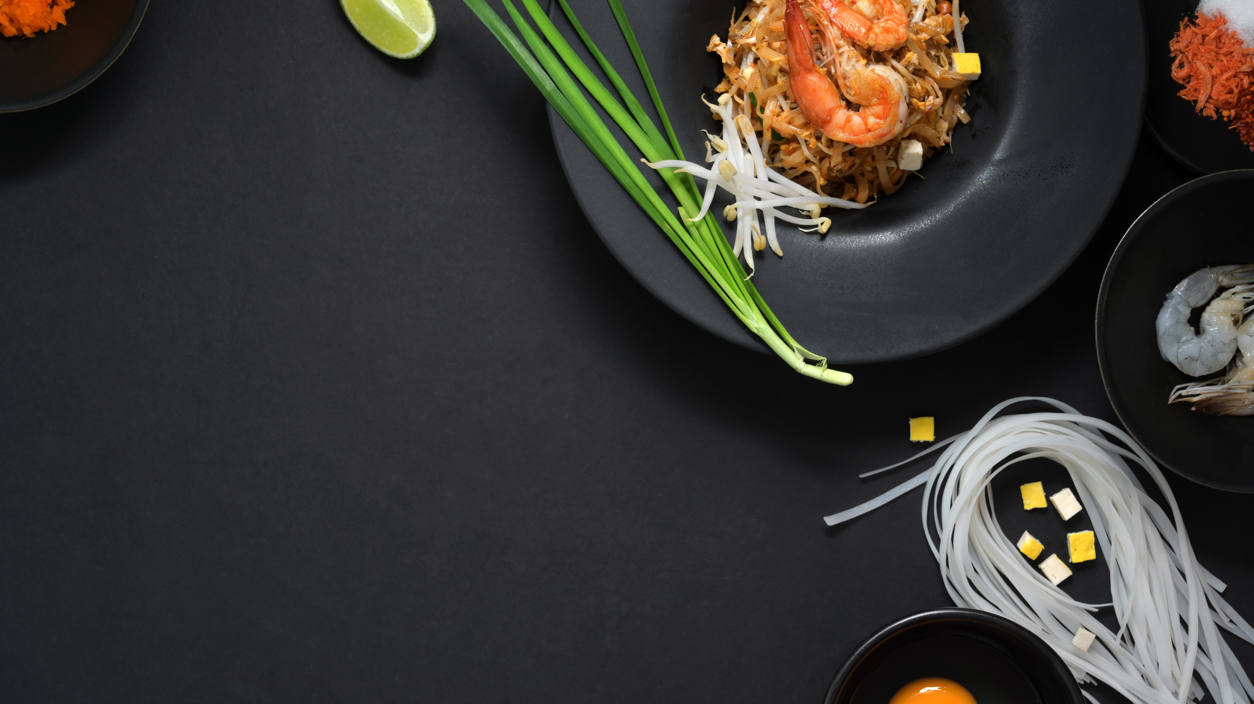
THANK YOU
Hope you enjoy your meal!
References:
https://www.businessprocessincubator.com/content/the-critical-challenges-faced-by-the-food-delivery-industry-today/
https://www.statista.com/statistics/1149288/india-amount-spent-per-order-on-food-delivery-apps/
https://ziphaccp.com/en/food-temperature/serving-food-temperature.html
By: Muskan Gupta, 3rd Year
Thapar Institute of Engineering and Technology

